Slide 1

Lea ning
Week 5:
Principal Component Analysis & Heatmaps

Slide 2


Slide 3
What’s on for today
Recap from last class:
Being a data detective: finding and fixing errors
Summarizing data
My first baRgraph
An introduction to the Week 5 Gapminder data set
My first PCA (hands-on R lesson)
My first Heatmap (hands-on R lesson)

Slide 4
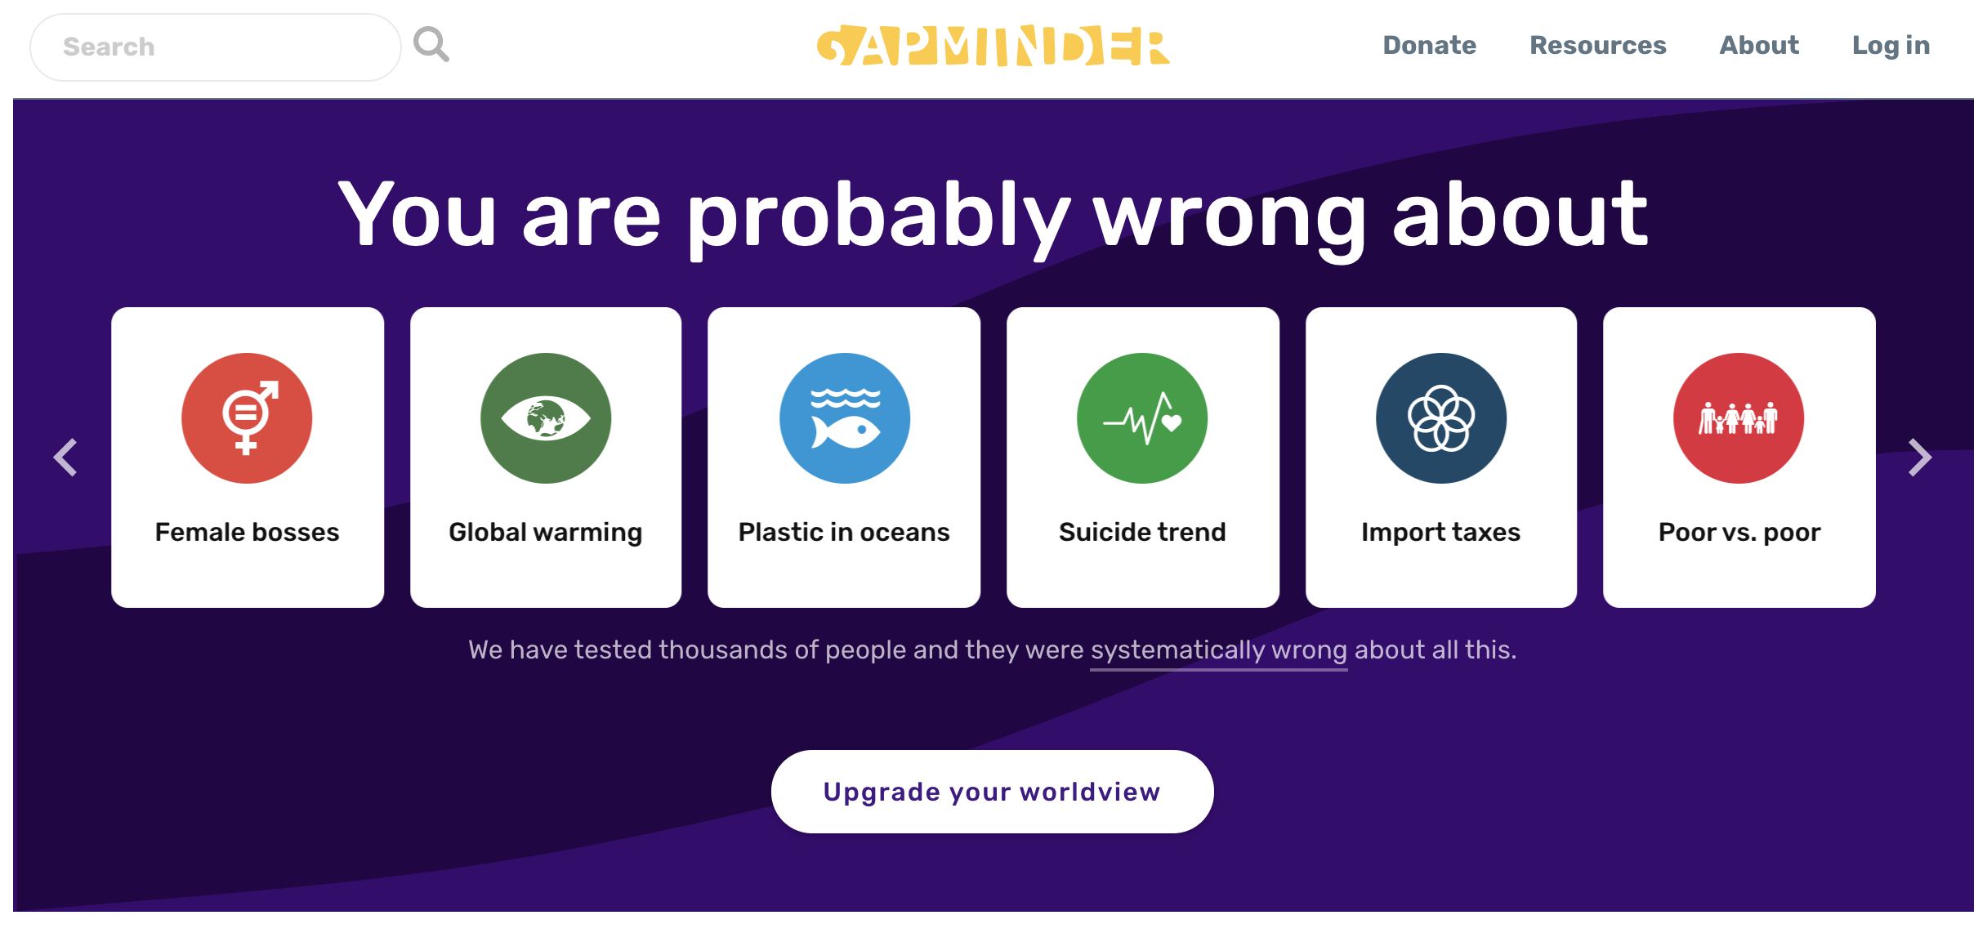
What is Gapminder? www.gapminder.org
“Our missing is to fight devastating ignorance with a fact-based worldview that everyone can understand”

Slide 5
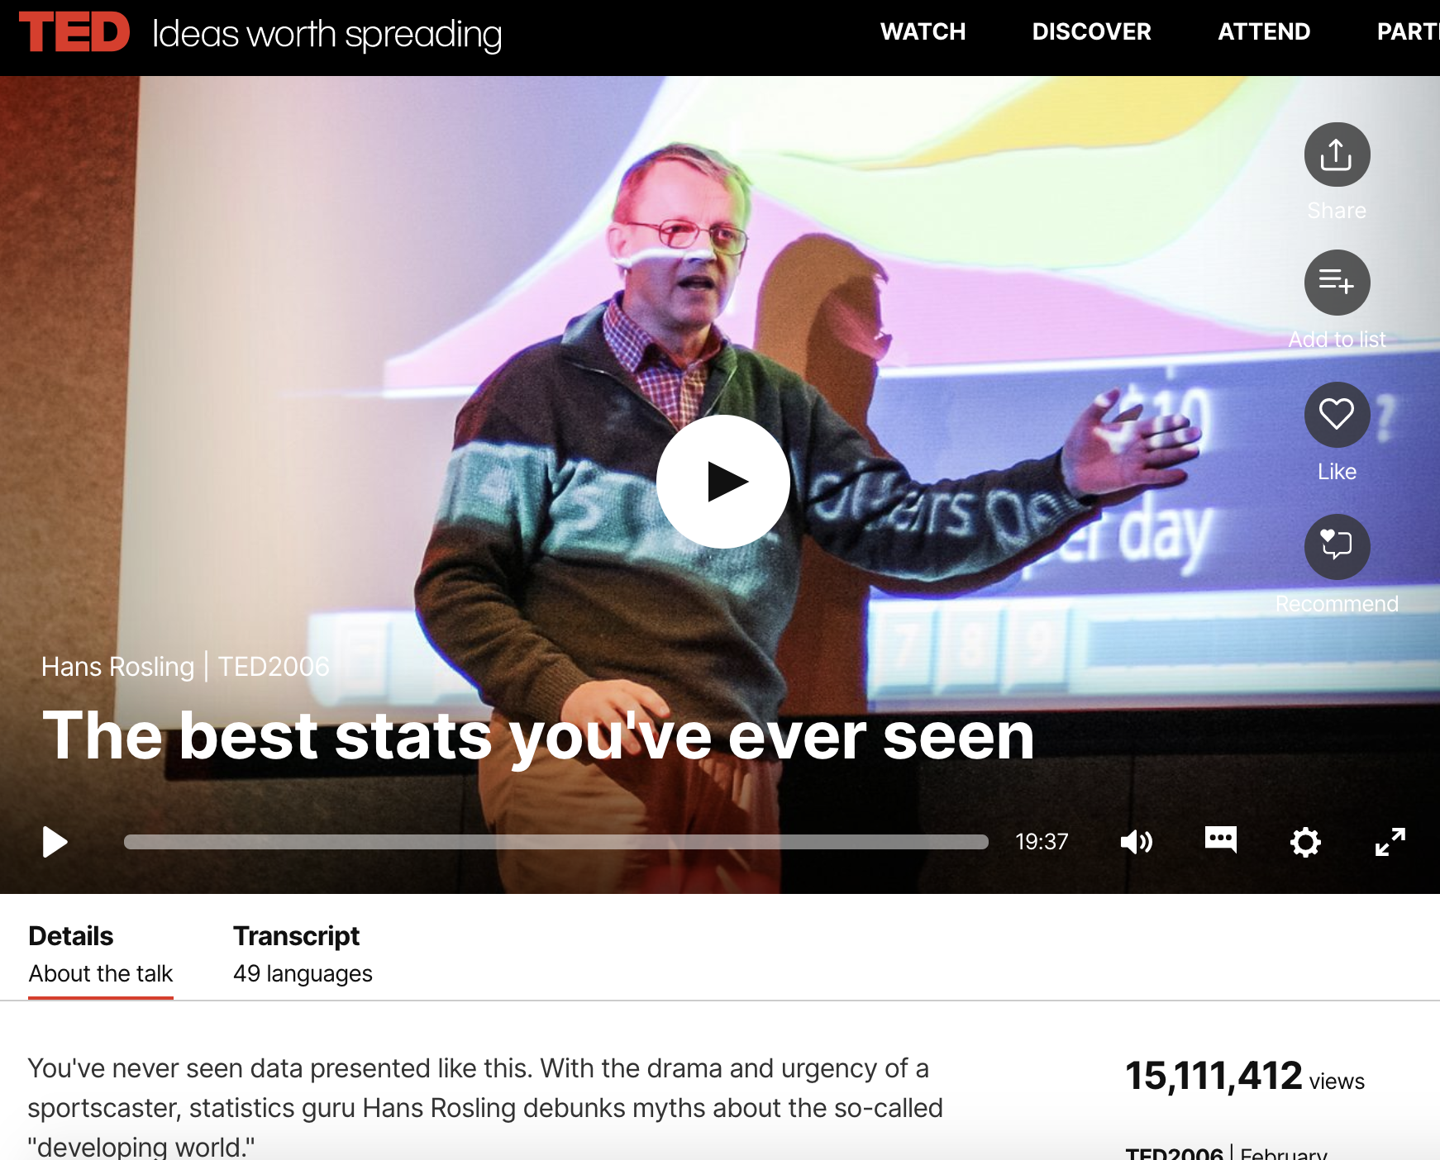
It started as a data repository…
… And turned into a movement
A Swedish-based initiative to bring together data on global health, economy, and social science top fight against bias and misinformation.
https://www.ted.com/talks/hans_rosling_the_best_stats_you_ve_ever_seen

Slide 6
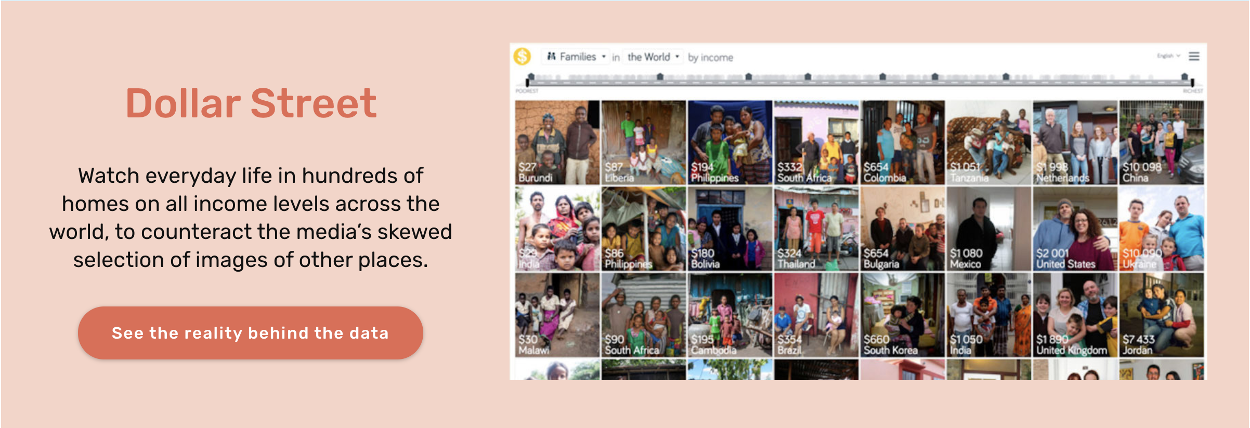

Slide 7
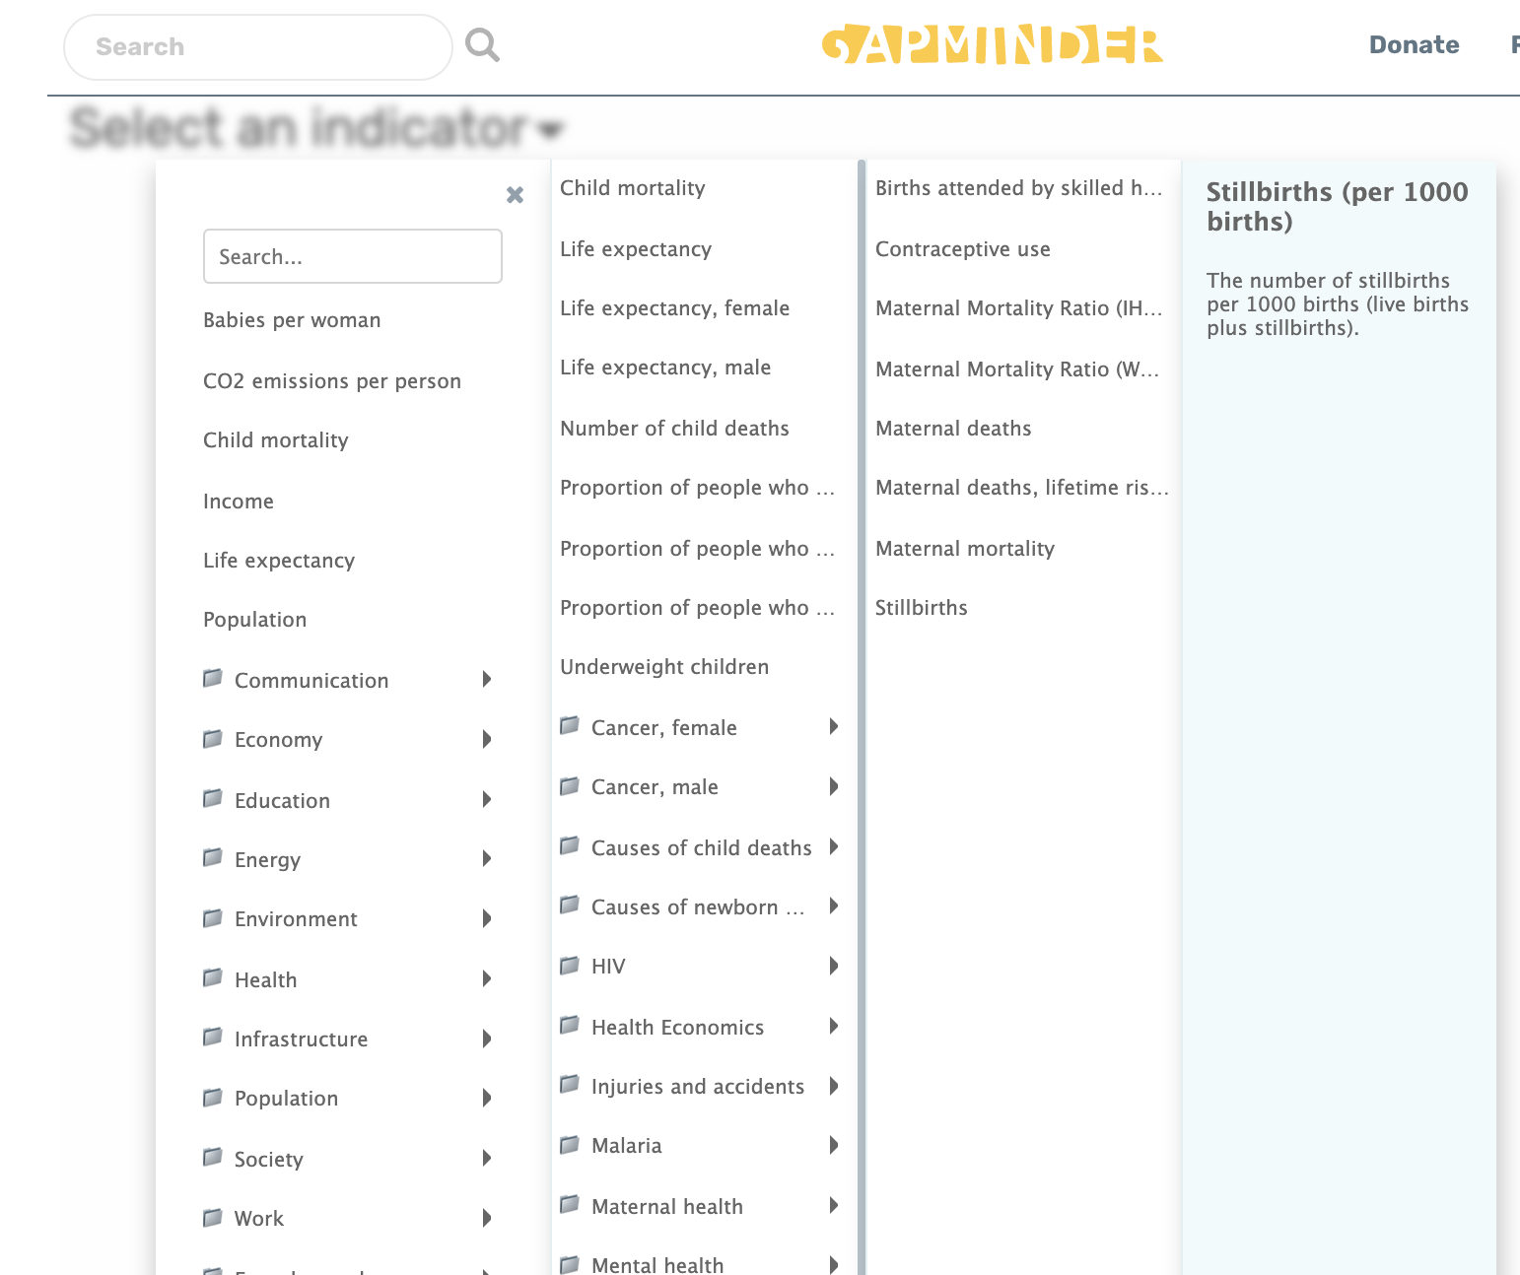
…And it also includes a LOT of data

Slide 8
Today’s mission
We are using data collated by GapMinder in 2012. It includes a few socioeconomic variable across 134 countries around the world.
We are going to apply data visualization tools beyond the boxplot to see if we can identify any relationships in our data

